Slide 1
Lecture 8- Proterozoic Eon
PT 1- Paleoproterozoic Era
PT 2- Mesoproterozoic Era
PT 3- Neoproterozoic Era

Slide 2
The Proterozoic Eon
2.5-0.541* Ga
Subdivisions still based on absolute dates
No stratotypes for Proterozoic time

Slide 3
Why Does it Start at 2.5 Ga?
Change in crustal evolution around this time
Archean cratons:
granitic-gneiss complexes
greenstone belts
komatiites
Proterozoic:
more unmetamorphosed units & sedimentary strata
All indicative of ‘modern’ tectonic processes having started by this point

Slide 4
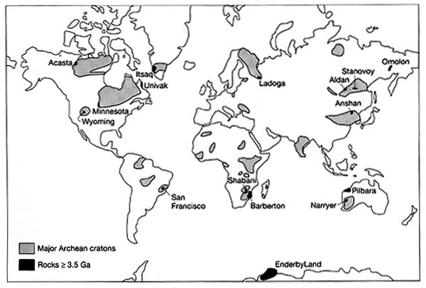
Continental Growth
Accretion along the Archean cratons
Earth still had more radiogenic heat
Q: what does this imply for tectonic rates?

Slide 5
PT 1- Paleoproterozoic Era
2.5-1.6 Ga (= 900 my, longer than some eons!)
Divided into 4 periods:
1- Siderian
2- Rhyacian
3- Orosirian
4- Statherian

Slide 6
Paleoproterozoic Era Tectonics
Cratons collided and suture together
Continental shields expand
Orogens common in many areas
Ophiolites in Russia & China
Metamorphism and pluton emplacement (batholiths)
Q: what’s a batholith?

Slide 7
Paleoproterozoic Life
Fossils limited to bacteria & stromatolites
Widespread during much of Proterozoic time
Bacteria diversifying
Cyanobacteria present (perhaps earlier)
Some eukaryotes evolving

Slide 8
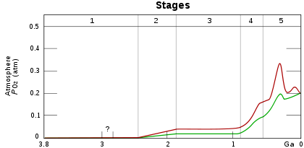
1A- Siderian Period
2.5-2.3 Ga (= 200 my)
2.4 Ga- Great Oxygenation Event (GOE)
aka Oxygen Catastrophe
Rapid O₂ production, starts building up in atmosphere
A lot still reduced in oceans

Slide 9
GOE Timing
If photosynthesis evolved ~ 3.5 Ga, why’d it take so long for appreciable O₂ production to start?
Time Lag Theory- after photosynthesis evolved, had to wait for oxygen sinks to fill

Slide 10
Time Lag Theory- Causes
Hypothesis 1- Nickel Famine- methanogens limited O₂ buildup
CH₄ + 2O₂ = CO₂ + 2H₂O
Methanogens need Ni for enzymatic rxns
Cooling/less volcanism = less Ni erupted ca 2.7-2.4 Ga

Slide 11
Time Lag Theory- Causes
Hypothesis 2- Bistability Hypothesis- more O₂ could accumulate after the ozone layer formed
O₃ UV shielding = less CH₄ oxidation

Slide 12
Time Lag Theory- Causes
Hypothesis 3- No time lag- photosynthesis evolved shortly before GOE

Slide 13
Sulfur Isotope Data
Hadean-Archean: MIF sulfur deposited
MIF S is created by photolysis of SO₂, which cannot happen if O₂ is present
Switch to MDF sulfur deposition around 2.4 Ga
Indicates O₂ was present & prevented MIF S depo-

Slide 14
Sulfur Isotope Data
But other factors might account for the MIF-MDF switch
Ex- glacial weathering
Ex- homogenization of marine sulfur during glaciation

Slide 15

Siderian Glacial Activity
2.4-2.1 Ga = Huronian Glaciation
aka Gowgandan glaciation
1st of Earth’s 5 major glaciations
1- Huronian
2- Varangian
3- Ordovician-Silurian
4- Carboniferous-Permian
5- Pleistocene
*Pongolan glaciation occurred earlier, but was limited in scope

Slide 16
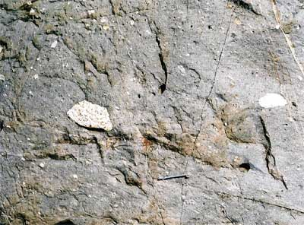
Huronian Glaciation
Prolonged & widespread
possibly 100-400 my long
Tillite conglomerates, polished & striated bedrock
Mich, Wyoming, Quebec
Other deposits (Australia, S Africa) may not be exactly the same age
Several small glaciations,
or one large one?
Tillite conglomerate (Can)

Slide 17
Huronian Glaciation- Cause
Possibly caused by GOE
oxidizing atmospheric methane removed that GG
Other possibilities:
higher obliquity
decrease in volcanism = less CO₂ added to the atmosphere
Did the GOE trigger the glaciation, or did the glaciation trigger the GOE …?

Slide 18
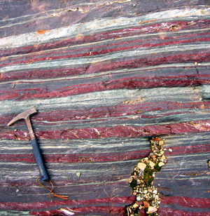
Siderian Rocks
Banded Iron Frm- Alternating layers of chert & iron-rich mins (hematite & magnetite)
Some Archean BIFs
reducing conditions allowed soluble iron accumulation in oceans
Most form 2.5-2.0 Ga
cyanobacteria added oxygen to the environment, allowed insoluble iron oxides to precipitate

Slide 19
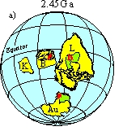
Siderian Continents
Kenorland Break-up began ~ 2.48 Ga
Coincides with Huronian glaciation
Kola & Karelia cratons separated by 2.4 Ga
Resulting cratons later became parts of
N America & Greenland (Laurentia)
Scandanavia (Karelia)
the Baltics (Kola)
Australia (Yilgam)
the Kalahari region

Slide 20
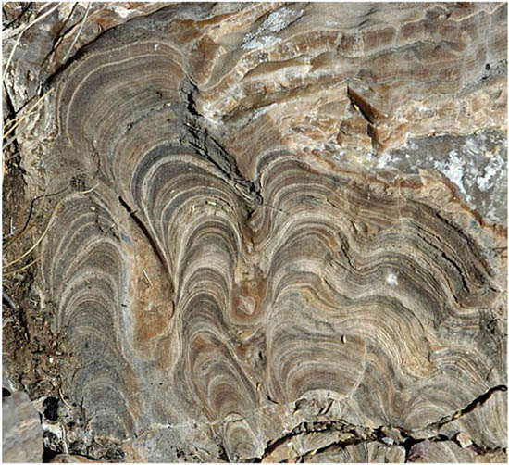
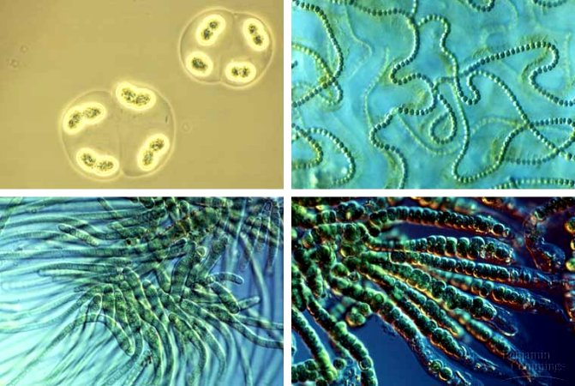
1B- Rhyacian Period
2.3-2.05 Ga (= 250 my)
Huronian glaciation ended ~ 2.2-2.1 Ga
Stromatolites becoming widespread
More cyanobacteria = more oxygen accumulating in the atmosphere

Slide 21
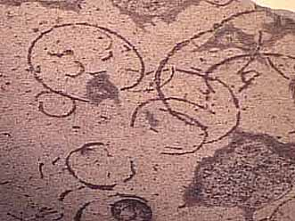
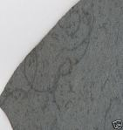
Rhyacian Life- More Complex
2.1 Ga- oldest recognized eukaryotic cells (Mich)
debated whether multicellular or protists
Grypania (2.1 Ga) possible eukaryotic algae
Nucleus & organelles
Most are aerobic
Most reproduce asexually
Q: what does this imply for evolutionary rates?

Slide 22
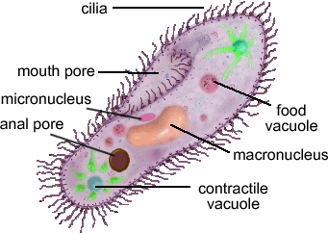
Endosymbiosis
Symbiotic relationship where one organism takes up residence within another
Possible origin of organelles
Some have their own genetic material
Protista- ‘kingdom’ of single-celled eukaryotes

Slide 23
Review: Paleoproterozoic Era
2.5-1.6 Ga
Divided into 4 periods:
1- Siderian
2- Rhyacian
3- Orosirian
4- Statherian

Slide 24
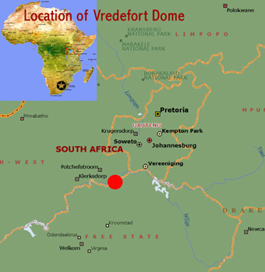
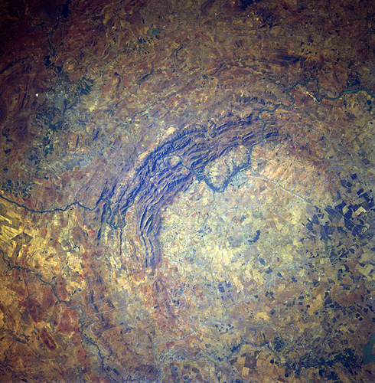
1C- Orosirian Period
2.05-1.8 Ga (= 250 my)
2 major impact events-
1- Vredefort- largest confirmed impact crater on Earth (S Africa)
ca 2.02 Ga
5-10 km impactor, 250-300 km crater

Slide 25
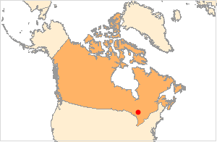
Orosirian Impacts
2- Sudbury basin, Canada
1.85 Ga
200 km crater

Slide 26
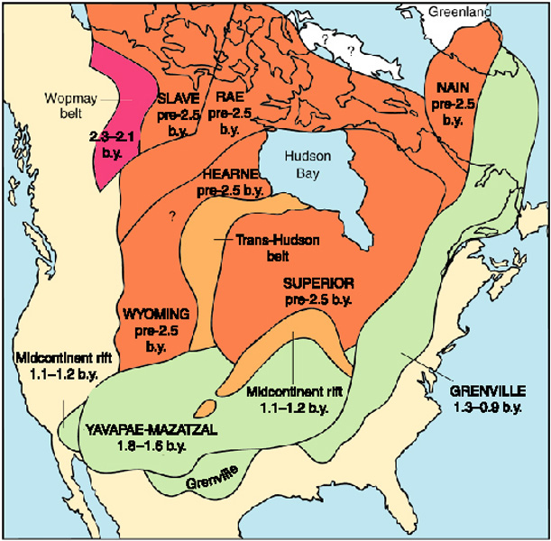
Orosirian Orogens
Significant orogenesis commenced worldwide
Wompay orogen (Can)- records a Wilson Cycle
Q: What’s a Wilson Cycle?
Initiate the frm of Laurentia btwn 2.0-1.8 Ga

Slide 27
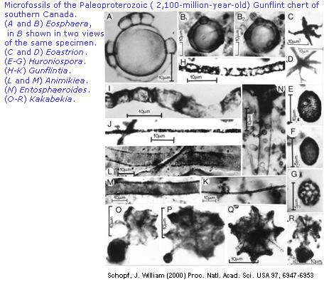
Orosirian Fossils
Gunflint Chert 1.9 Ga
BIF in Minnesota-Ontario
Both yield fossils of numerous photosynthetic prokaryotes

Slide 28
1D- Statherian Period
1.8-1.6 Ga (= 200 my)
Early stages of increased igneous activity across Laurentia
builds during the following Mesoproterozoic Era

Slide 29
Statherian Period Orogens
Increased orogenic activity continued
Thelon orogen- NW Canada, Slave + Rae cratons
Trans-Hudson orogen- Supperior, Hearne, + Wyoming cratons
Laurentia grew via accretion along its southern margin (Yavapai & Mazatzal-Pecos orogenies)

Slide 30
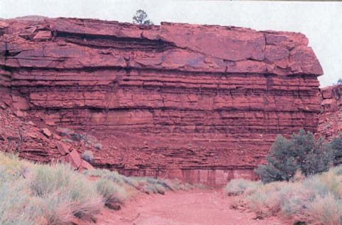
Statherian Period Rocks
Continental Red Beds- SS and Sh w/ oxidized iron minerals
e.g. hematite
Earliest ~ 1.8 Ga
Indicates free oxygen in the atmosphere (not just in seawater)
Still in low concentration
O₂ + UV radiation = O + O₃, both of which oxidize minerals
Moenkopi Frm
(younger)

Slide 31
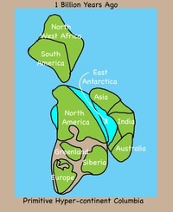
Statherian Continents
Columbia
aka Nuna, Hudsonland
Supercontinent
2.1 Ga
Most Statherian-age continental crust was incorporated
Grew at subduction zones along its margins

Slide 32
PT 2- Mesoproterozoic Era
1.6-1.0 Ga (= 600 my)
3 Periods:
Calymmian
Ectasian
Stenian

Slide 33
2A- Calymmian Period
1.6-1.4 Ga (=200 my)
Extensive Laurentian intrusives & volcanics 1.8-1.1 Ga
Not orogen-related
Possible hot spot beneath Columbia
Added to pre-existing continental crust
Now buried except in eastern Canada, Greenland, and Scandanavia’s Baltic shield

Slide 34
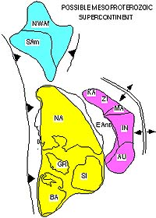
Calymmian Continents
1.6 Ga- rifting along Laurentia’s western margin marks the breakup of Columbia

Slide 35
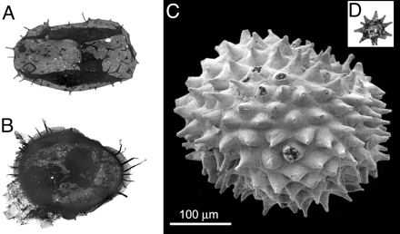
Calymmian Fossils
Acritarchs
FAD in Archean (3.2 Ga)
Diversify during Calymmian
‘cell-like’ fossils
Not even clear what
Kingdom they belong in
cysts of floating algae
phytoplankton related to dinoflagellates
Good index fossils for Proterozoic strata

Slide 36
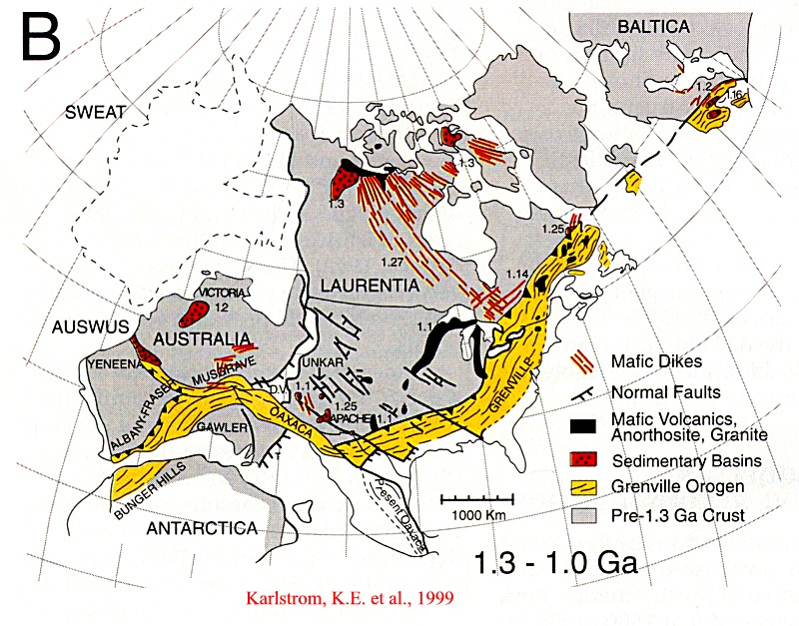
2B- Ectasian Period
1.4-1.2 Ga (= 200 my)
Grenville orogeny began in SE Laurentia (1.3 Ga)

Slide 37
Grenville Orogney
Northern Appalachia & eastern Canada, Greenland, Scandanavia exposures
Possibly via Wilson cycle closure
Grenville rks heavily deformed in NA when Appalachian mts were later uplifted during the Paleozoic Era

Slide 38
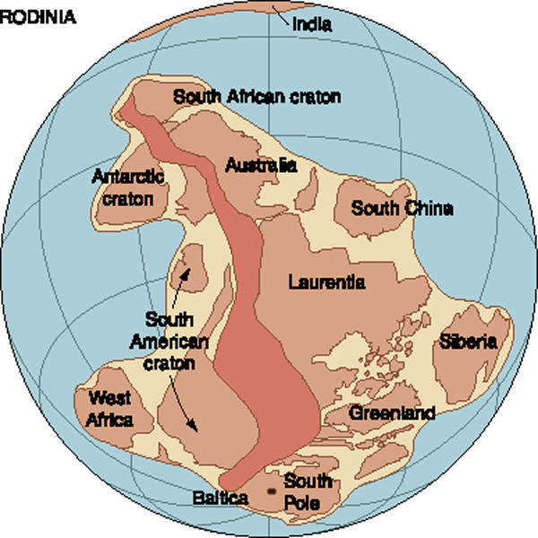
Ectasian Supercontinent
Rhodinia- begins assembling by 1.3 Ga
Grenville orogeny was just one of the collisions involved

Slide 39
2C- Stenian Period
1.2-1.0 Ga (=200 my)
Grenville orogeny concluded ~ 1.0 Ga
Final stage of Laurentia accretion during the Proterozoic Eon
ca 75% of modern N America had formed by this point
Rhodinia assembly also completed ~ 1.0 Ga

Slide 40
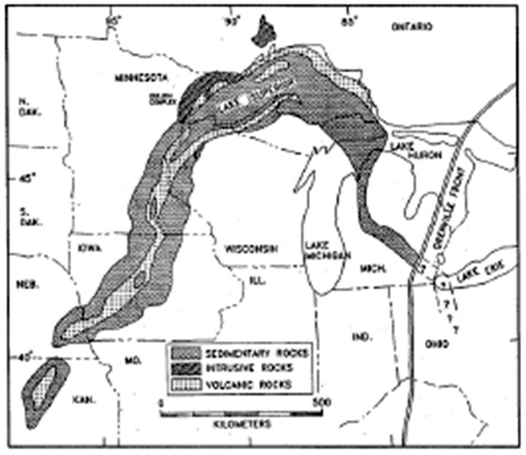
Stenian Tectonics
Midcontinent Rift began opening ~ 1.1 Ga
Fault-bound branching trough in modern Midwestern US
1 SW from Lake Superior to Kansas
1 S-SE through Mich-Ohio

Slide 41
Midcontinent Rift- Origin
Failed rift valley system in Ontario
Q: What’s a rift valley?
Massive basaltic flows (300,000-1 million km³)
Active < 20 my (sometime btwn 1.2-1.0 Ga)

Slide 42
PT 3- Neoproterozoic Era
1000-542* Ma (= 458 my)
Divided into 3 periods:
1- Tonian Period
2- Cryogenian Period
3- Ediacaran Period
Sedimentation in several parts of Laurentia
Montana, Idaho, Alberta
Nevada-California
eastern US

Slide 43
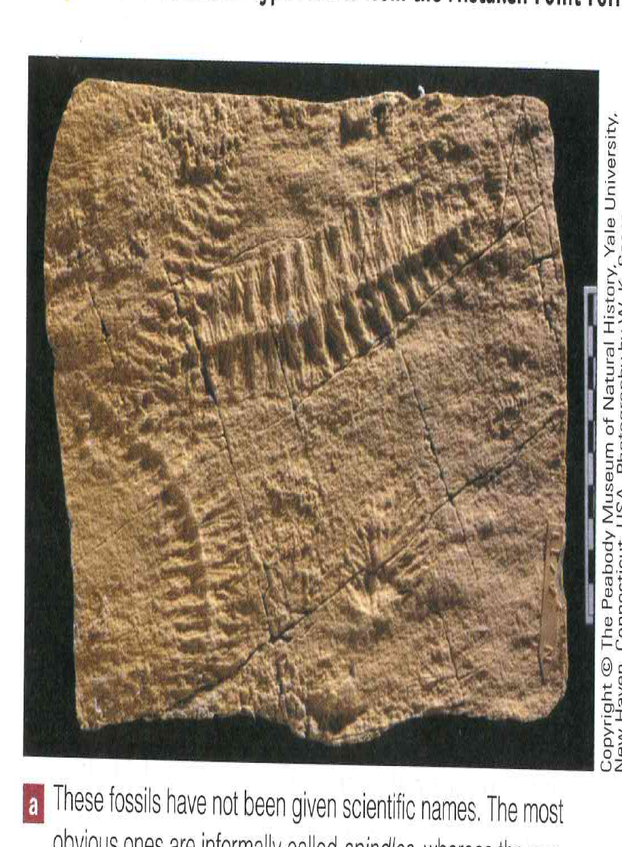
3A- Tonian Period
1000-850 Ma (= 150 my)
Some glacial deposits formed ~ 900 Ma
Some possible animal fossils (tiny worm burrows) ~ 900-700 Ma (China)

Slide 44
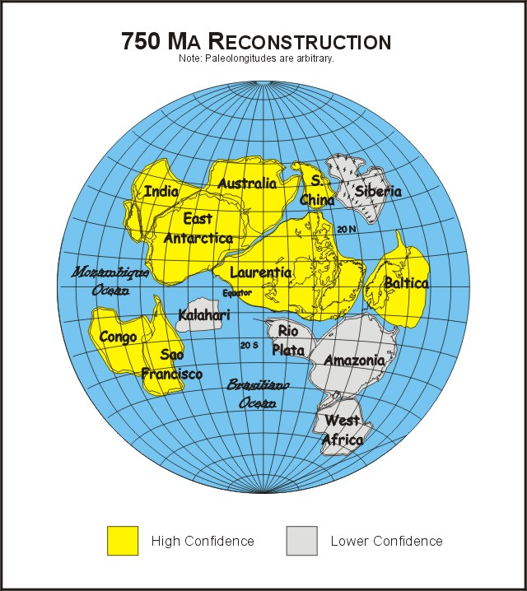
3B- Cryogenian Period
850-635 Ma (=220 my)
Q: what does the Period’s name imply?
Rhodinia separating by 750 Ma
Opened the proto-Pacific ocean Panthalassa

Slide 45
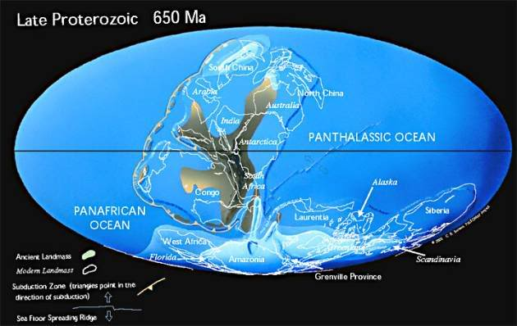
Cryogenian Period Continents
Some sections of Rhodinia reassembled ~ 650 Ma to form Pannotia
Pan-African orogeny was one step

Slide 46
Cryogenian Cryosphere
Varangian Glaciation
aka Snowball Earth
Earth’s 2nd major, and most extensive, glaciation
All continents but Antarctica contained glaciers
Extended to near-equatorial regions
Continental & oceanic ice sheets possible

Slide 47
Varangian Glaciation
Extensive deposits 900-600 Ma
Tillites
Dropstones/erratics
Striated bedrock
Varves
4 major glacial pulses

Slide 48
Varangian Ice Age- Cause
Hypothesis 1- high albedo
Continents at low latitudes may have reflected lots of insolation
Relatively small tropical oceans to absorb heat

Slide 49
Varangian Ice Age- Cause
Hypothesis 2- reduced atmospheric CO₂
Spread of photosynthetic organisms that utilize CO₂ removed lots of that GG from the atmosphere

Slide 50
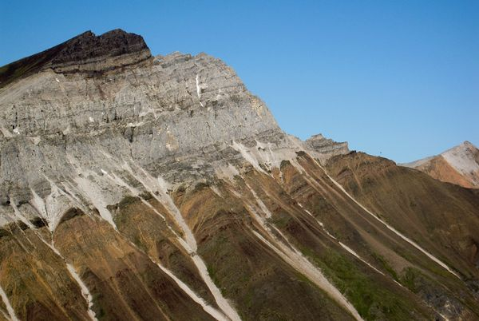
Varangian Glacial Carbonates
Tillites assoc w/ LS in some areas. Unusual.
Q: why is that combo unusual?
Possibly signal short interglacial pulses tied to atmospheric buildup of CO₂
Less photosynthetic draw-down during glacial pulses
Q: what type of feedback system does that represent?
CANADA
Limestones
Glacial depos

Slide 51
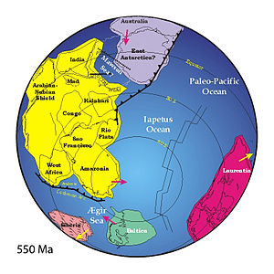
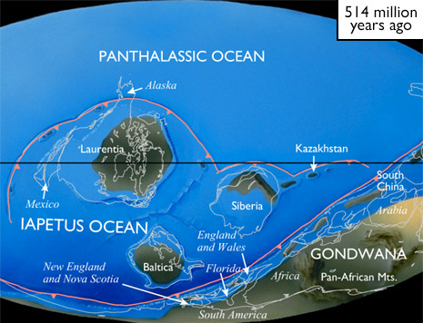
3C- Ediacaran Period
635-541* Ma (= 88 my)
Pannotia started fragmenting by 550 Ma
Iapetus Ocean opens in southern hemisphere
Between Laurentia & other cratons

Slide 52
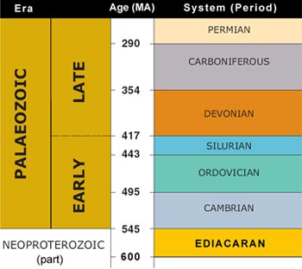
Ediacaran Fauna
FAD ca 630 Ma
1st undisputed metazoan fossils
1st from Australia (1947), now known from all continents except Antarctica
Some in N Carolina

Slide 53
Ediacaran Fauna
Hard skeletal parts just beginning to evolve
chitonous carapaces
Q: why are hard skeletal parts important to geologists?

Slide 54
Ediacaran Fauna
Sudden appearance
radiation following Varangian extinction?
3 modern Phyla included
Arthopoda
Annelida
Cnidaria

Slide 55
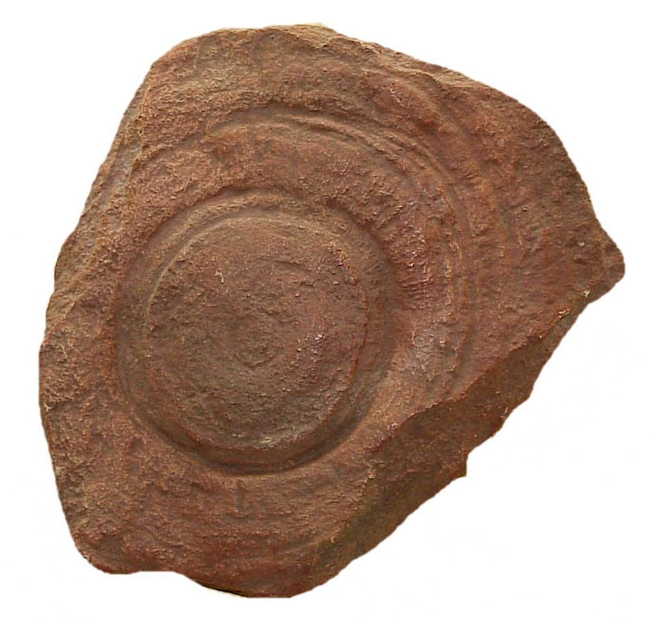
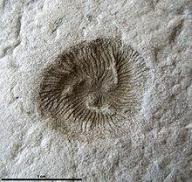
Ediacaran Forms
Cnidarians = ‘discoid’ forms
jellyfish
Ex: Cyclomedusa (L)
Tribrachidium (R)= extinct trilateral phylum?

Slide 56
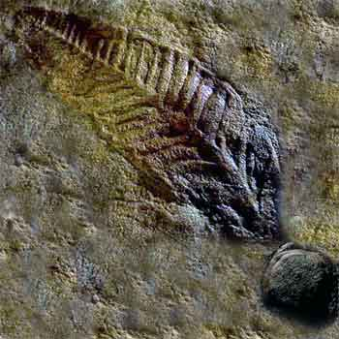
Ediacaran Forms
‘Frond-like’ forms similar to sea pen corals
Charniodiscus

Slide 57
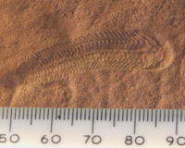
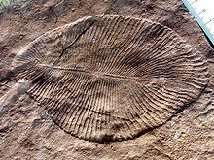
Ediacaran Forms
Annelids = ‘Elongate forms’
worms
Dickinsonia (1m long!)
Spriggina
?trilobite precursor
Dickinsonia costata

Slide 58
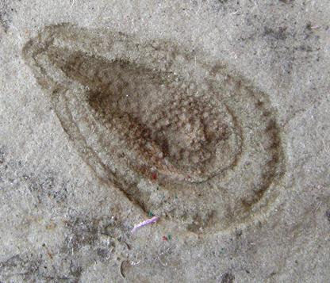
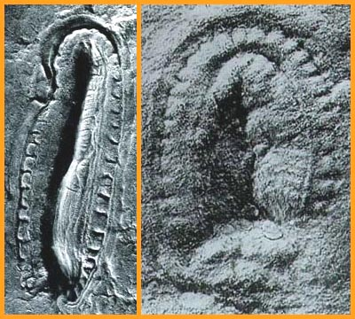
Ediacaran Forms
Kimberella
Advanced invert form ca 10 my prior to the Cambrian Explosion
Evidence of a coelum (body cavity) = digestive tract
Bilateral symmetry
Possible molluscan precursor
Pseudo-mantle
No radula

Slide 59
Vendoza Taxa
Some argue Ediacara fossils do not fit into modern phyla
They state the similarities are superficial
Q: what evolutionary process would this represent?
Problem: how did soft-bodied worms leave impressions in coarse SS?

Slide 60
Other Ediacaran Fossils
Stromatolites decrease in abundance during the late Proterozoic Eon
relatively rare for the rest of earth history
Hypothesis- diversification of grazers
today they’re only found in areas inhospitable to many marine invertebrate grazers

Slide 61
End of the Proterozoic Eon
Atmosphere approached 10% of present O₂ levels
Shells about to evolve and become widespread, marking the beginning of a much more prolific fossil record

